Slide 1
Directing the Audience

Slide 2
Preattentive attributes introduction
Primary goal of data visualization?
Make it easier to see patterns, trends or insights
How do we do that?
Removing clutter
Focusing attention

Slide 3
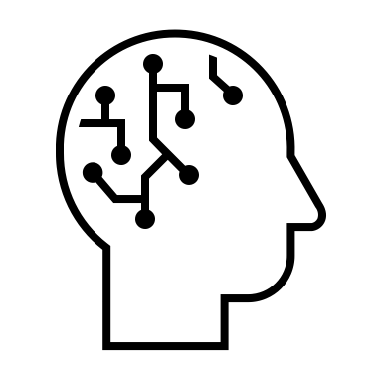
Memory review
Input
Processing
Storage
Sensory
Memory
Working
Memory
Long-term
Memory
< 1 second
< 1 minute
Up to a lifetime
Sensory (or Iconic) Memory
Holds information for a fraction of a second
Tuned to a set of preattentive attributes
Short-term (or Working) memory
People can keep about four chunks of visual information in their short-term memory
Long-term memory
Aggregate of visual and verbal memory, which work differently
Images can help us recall things quicker

Slide 4
Memory review
Input
Processing
Storage
Sensory
Memory
Working
Memory
Long-term
Memory
< 1 second
< 1 minute
Up to a lifetime
Sensory (or Iconic) Memory
Holds information for a fraction of a second
Tuned to a set of preattentive attributes
Short-term (or Working) memory
People can keep about four chunks of visual information in their short-term memory
Long-term memory
Aggregate of visual and verbal memory, which work differently
Images can help us recall things quicker
Studies show that we have 3-8 seconds before audiences decide whether they will continue looking at a piece of content.

Slide 5
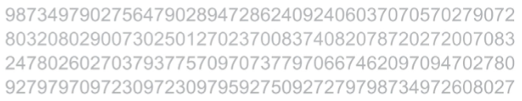
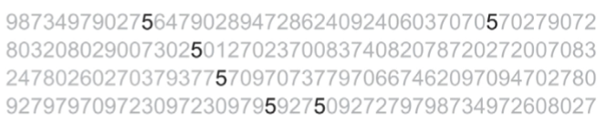
How many fives?
Preattentive attributes enable our audience to see what we want them to see before they even know they’re seeing it!

Slide 6
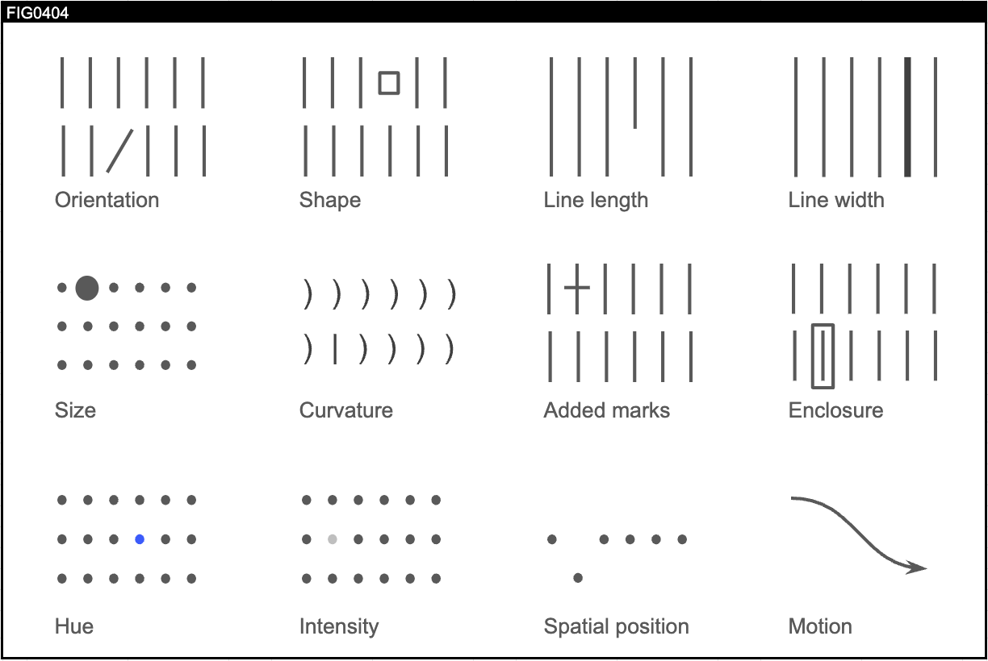
Preattentive attributes
These are all the preattentive attributes
Note that people tend to associate quantitative values for some (but not all) preattentive attributes
Preattentive attributes are used for:
Drawing your audience’s attention
Creating a visual hierarchy of information

Slide 7
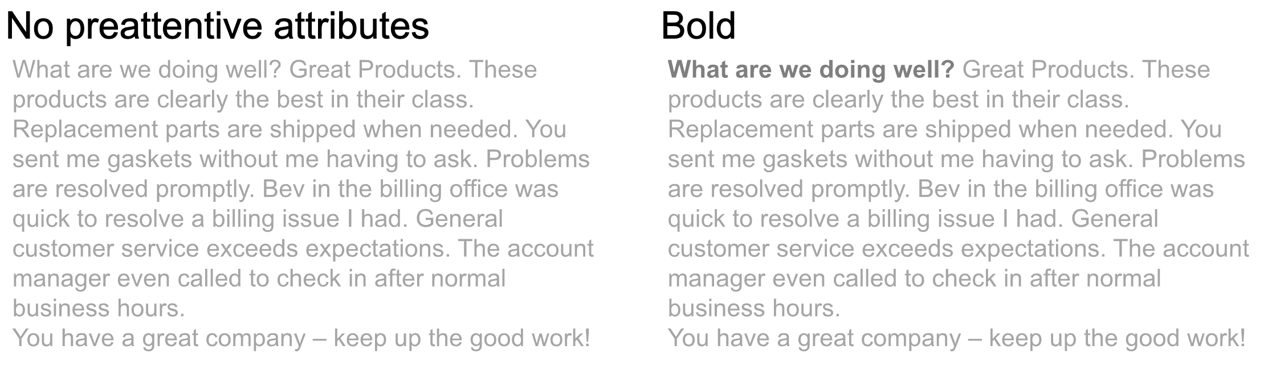
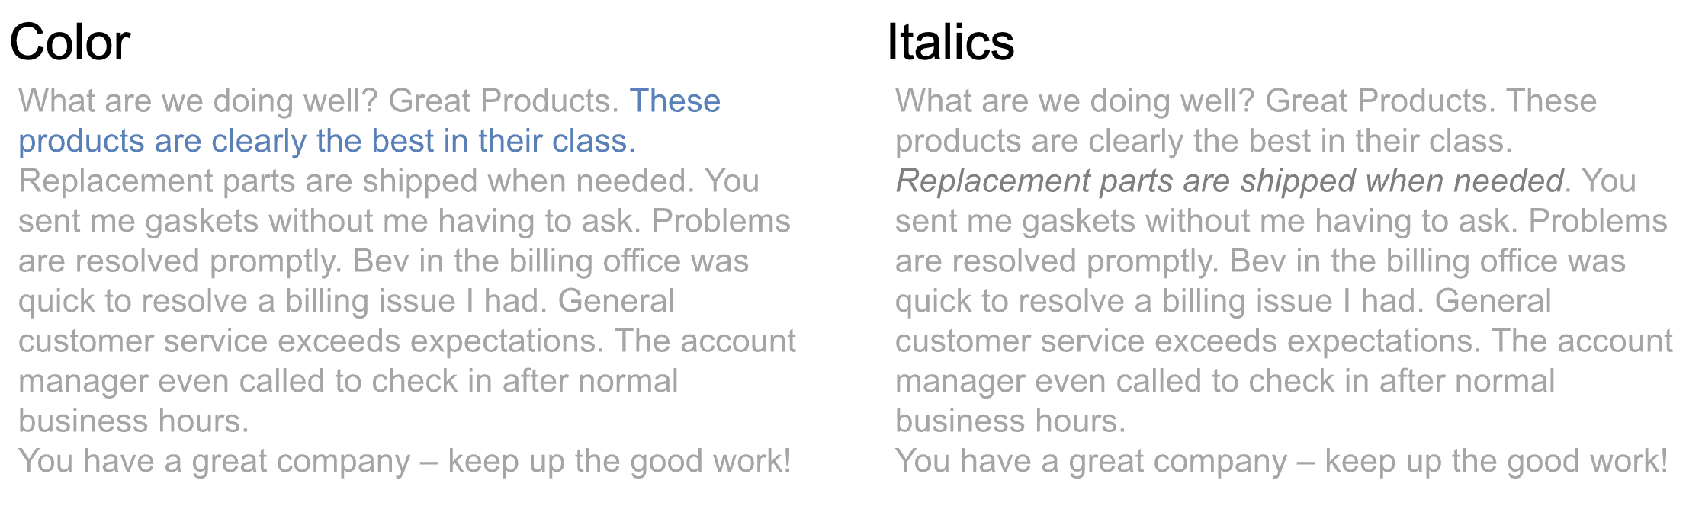
Preattentive attributes in text

Slide 8
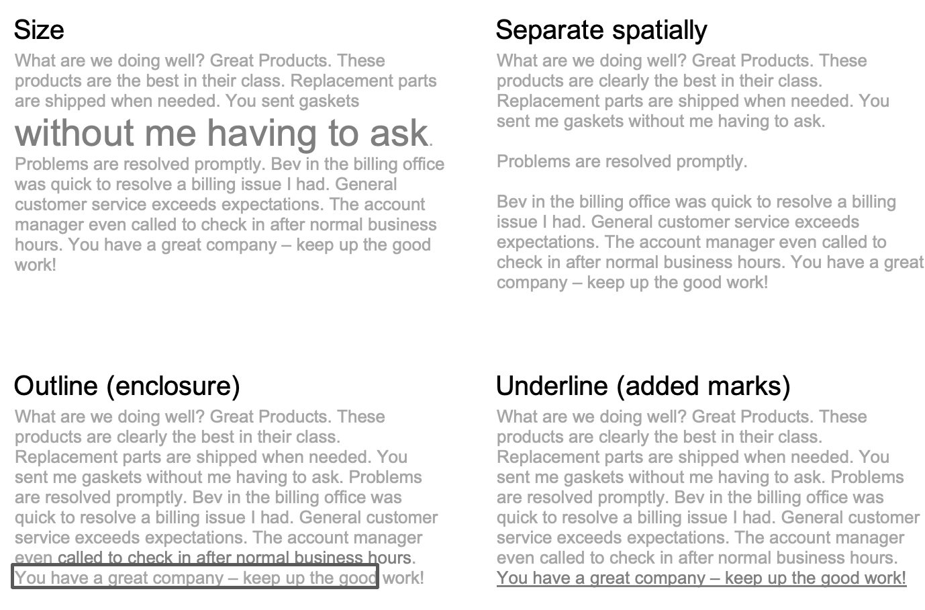
Preattentive attributes in text

Slide 9
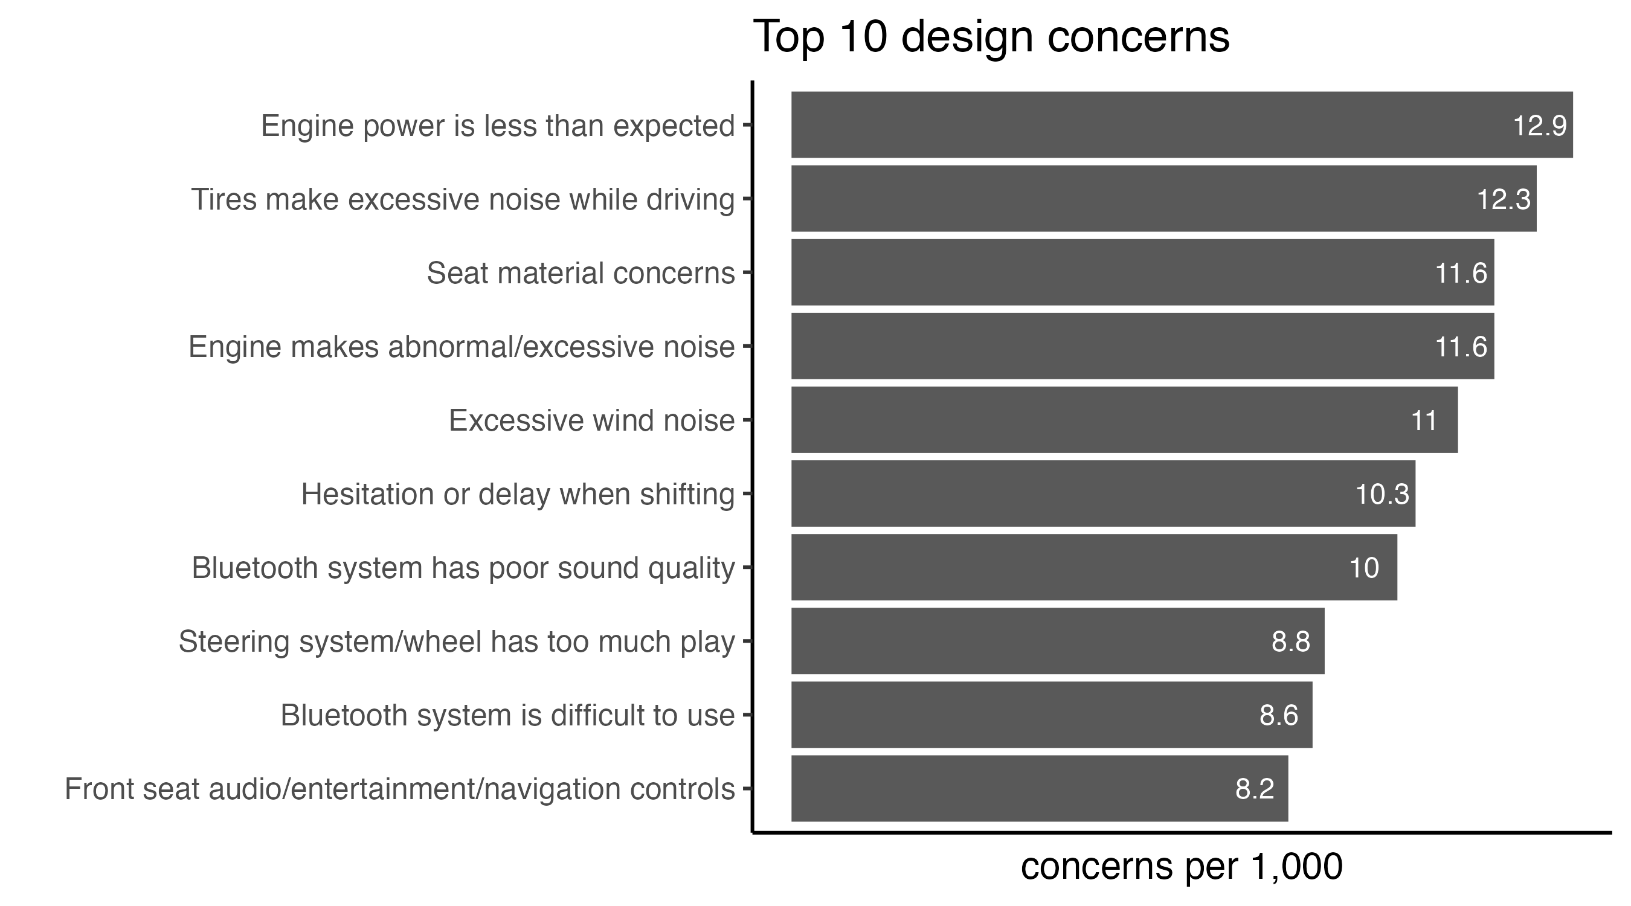
Preattentive attributes in charts
What is notable about this chart?
What do I want you to understand about the chart?
What insights do you see?

Slide 10
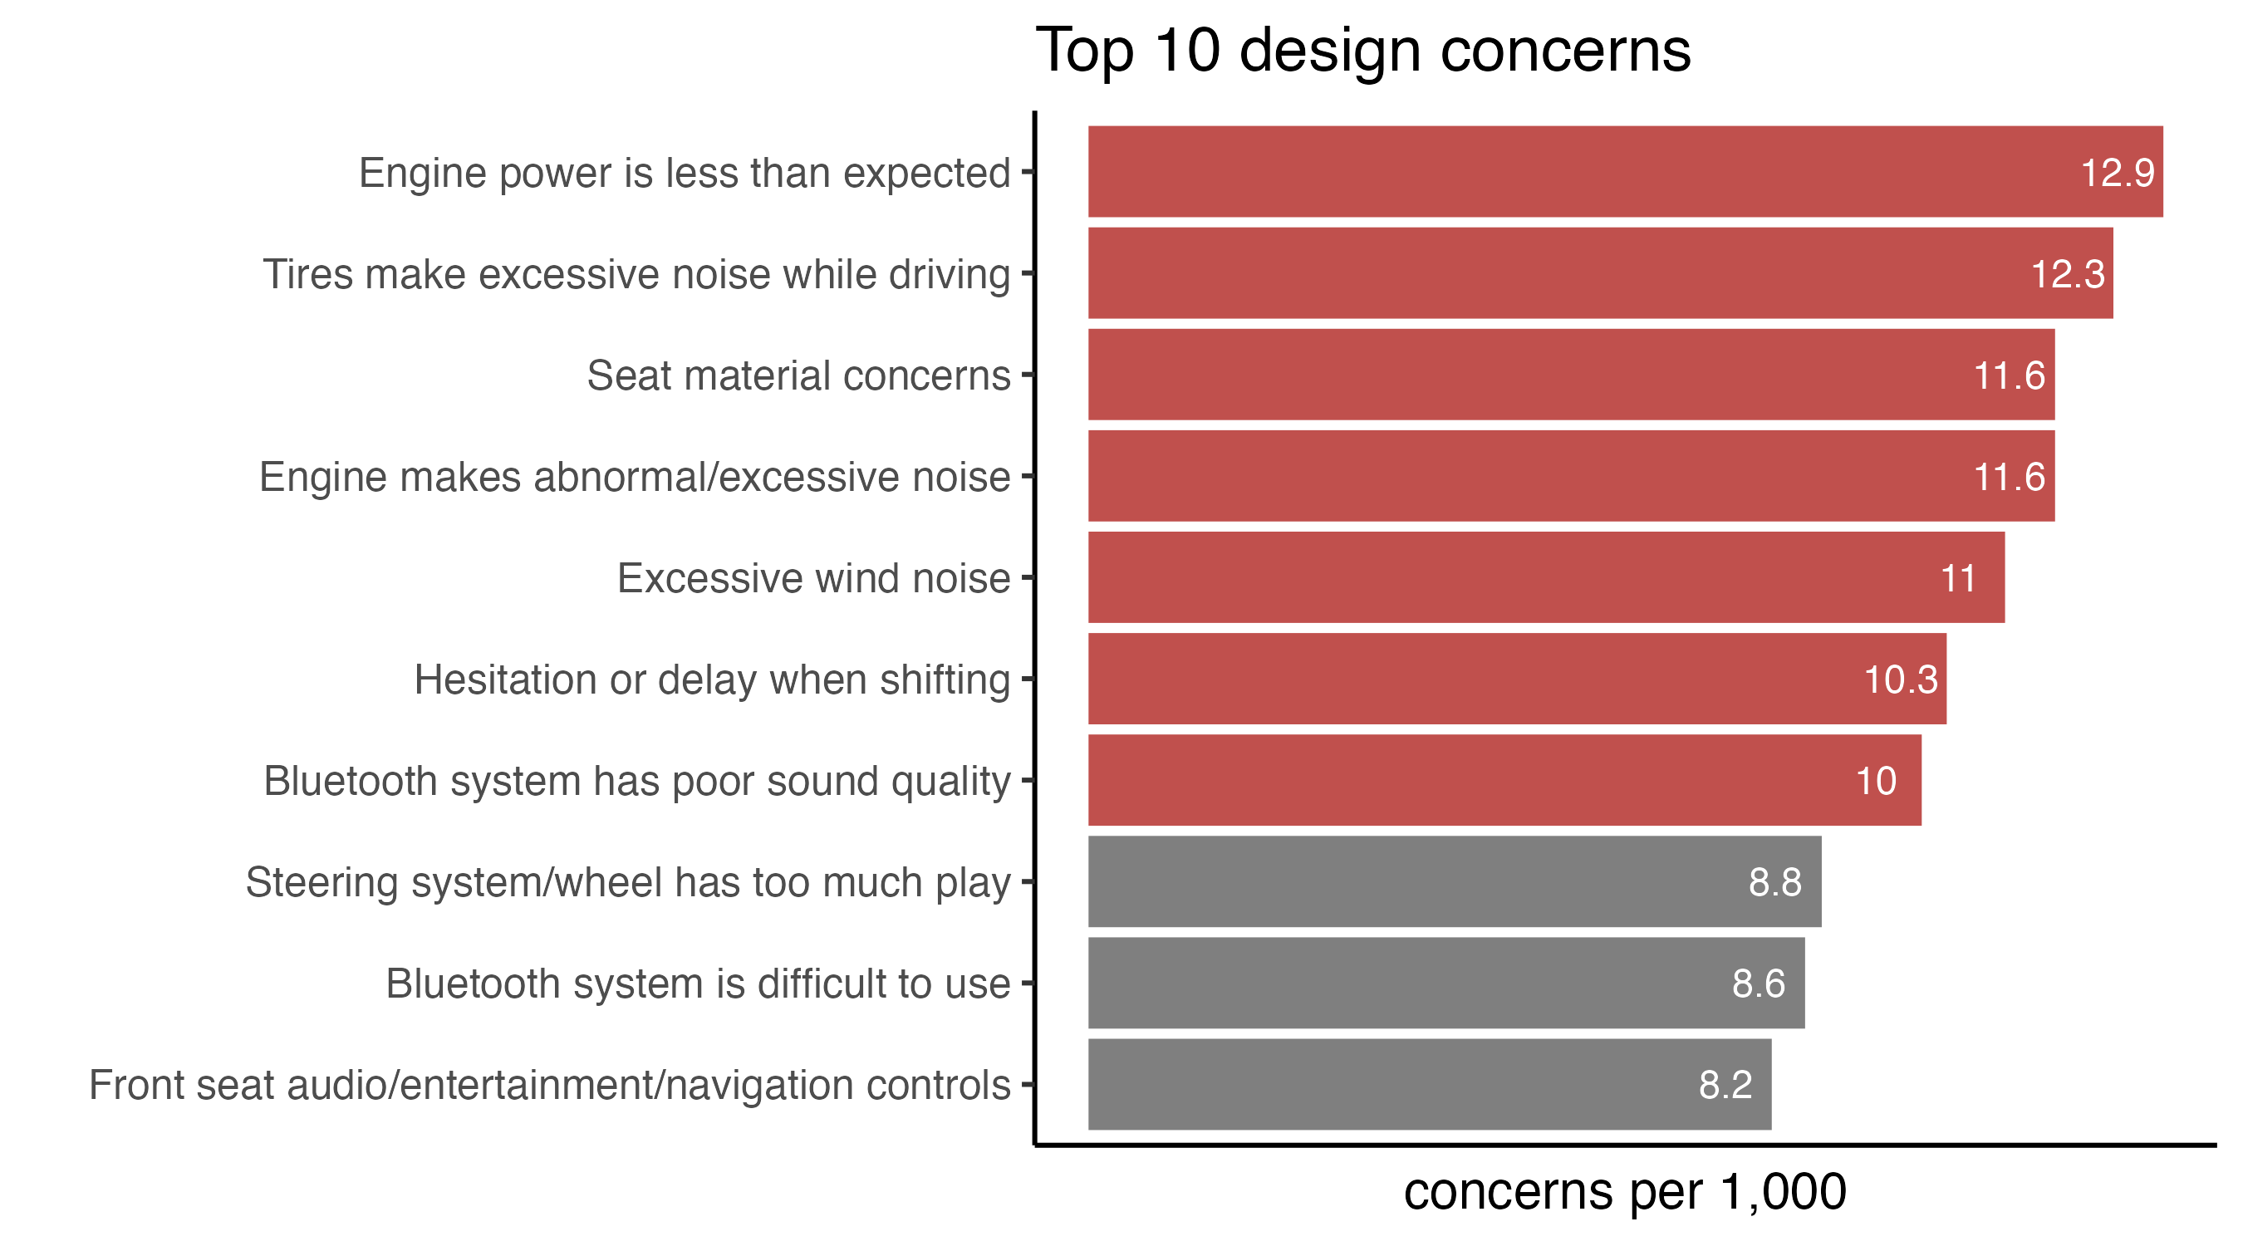
Add preattentive attributes
7 of the top 10 design concerns have 10 or more concerns per 1,000.
Is this an acceptable default rate?
What have we done to the chart?
How does it enhance our understanding?
Notes:
When we add pre-attentiVe attributes, the chart has a specific message, we have used pre-attentive attributes to focus the audience’s attention and make a specific point.

Slide 11
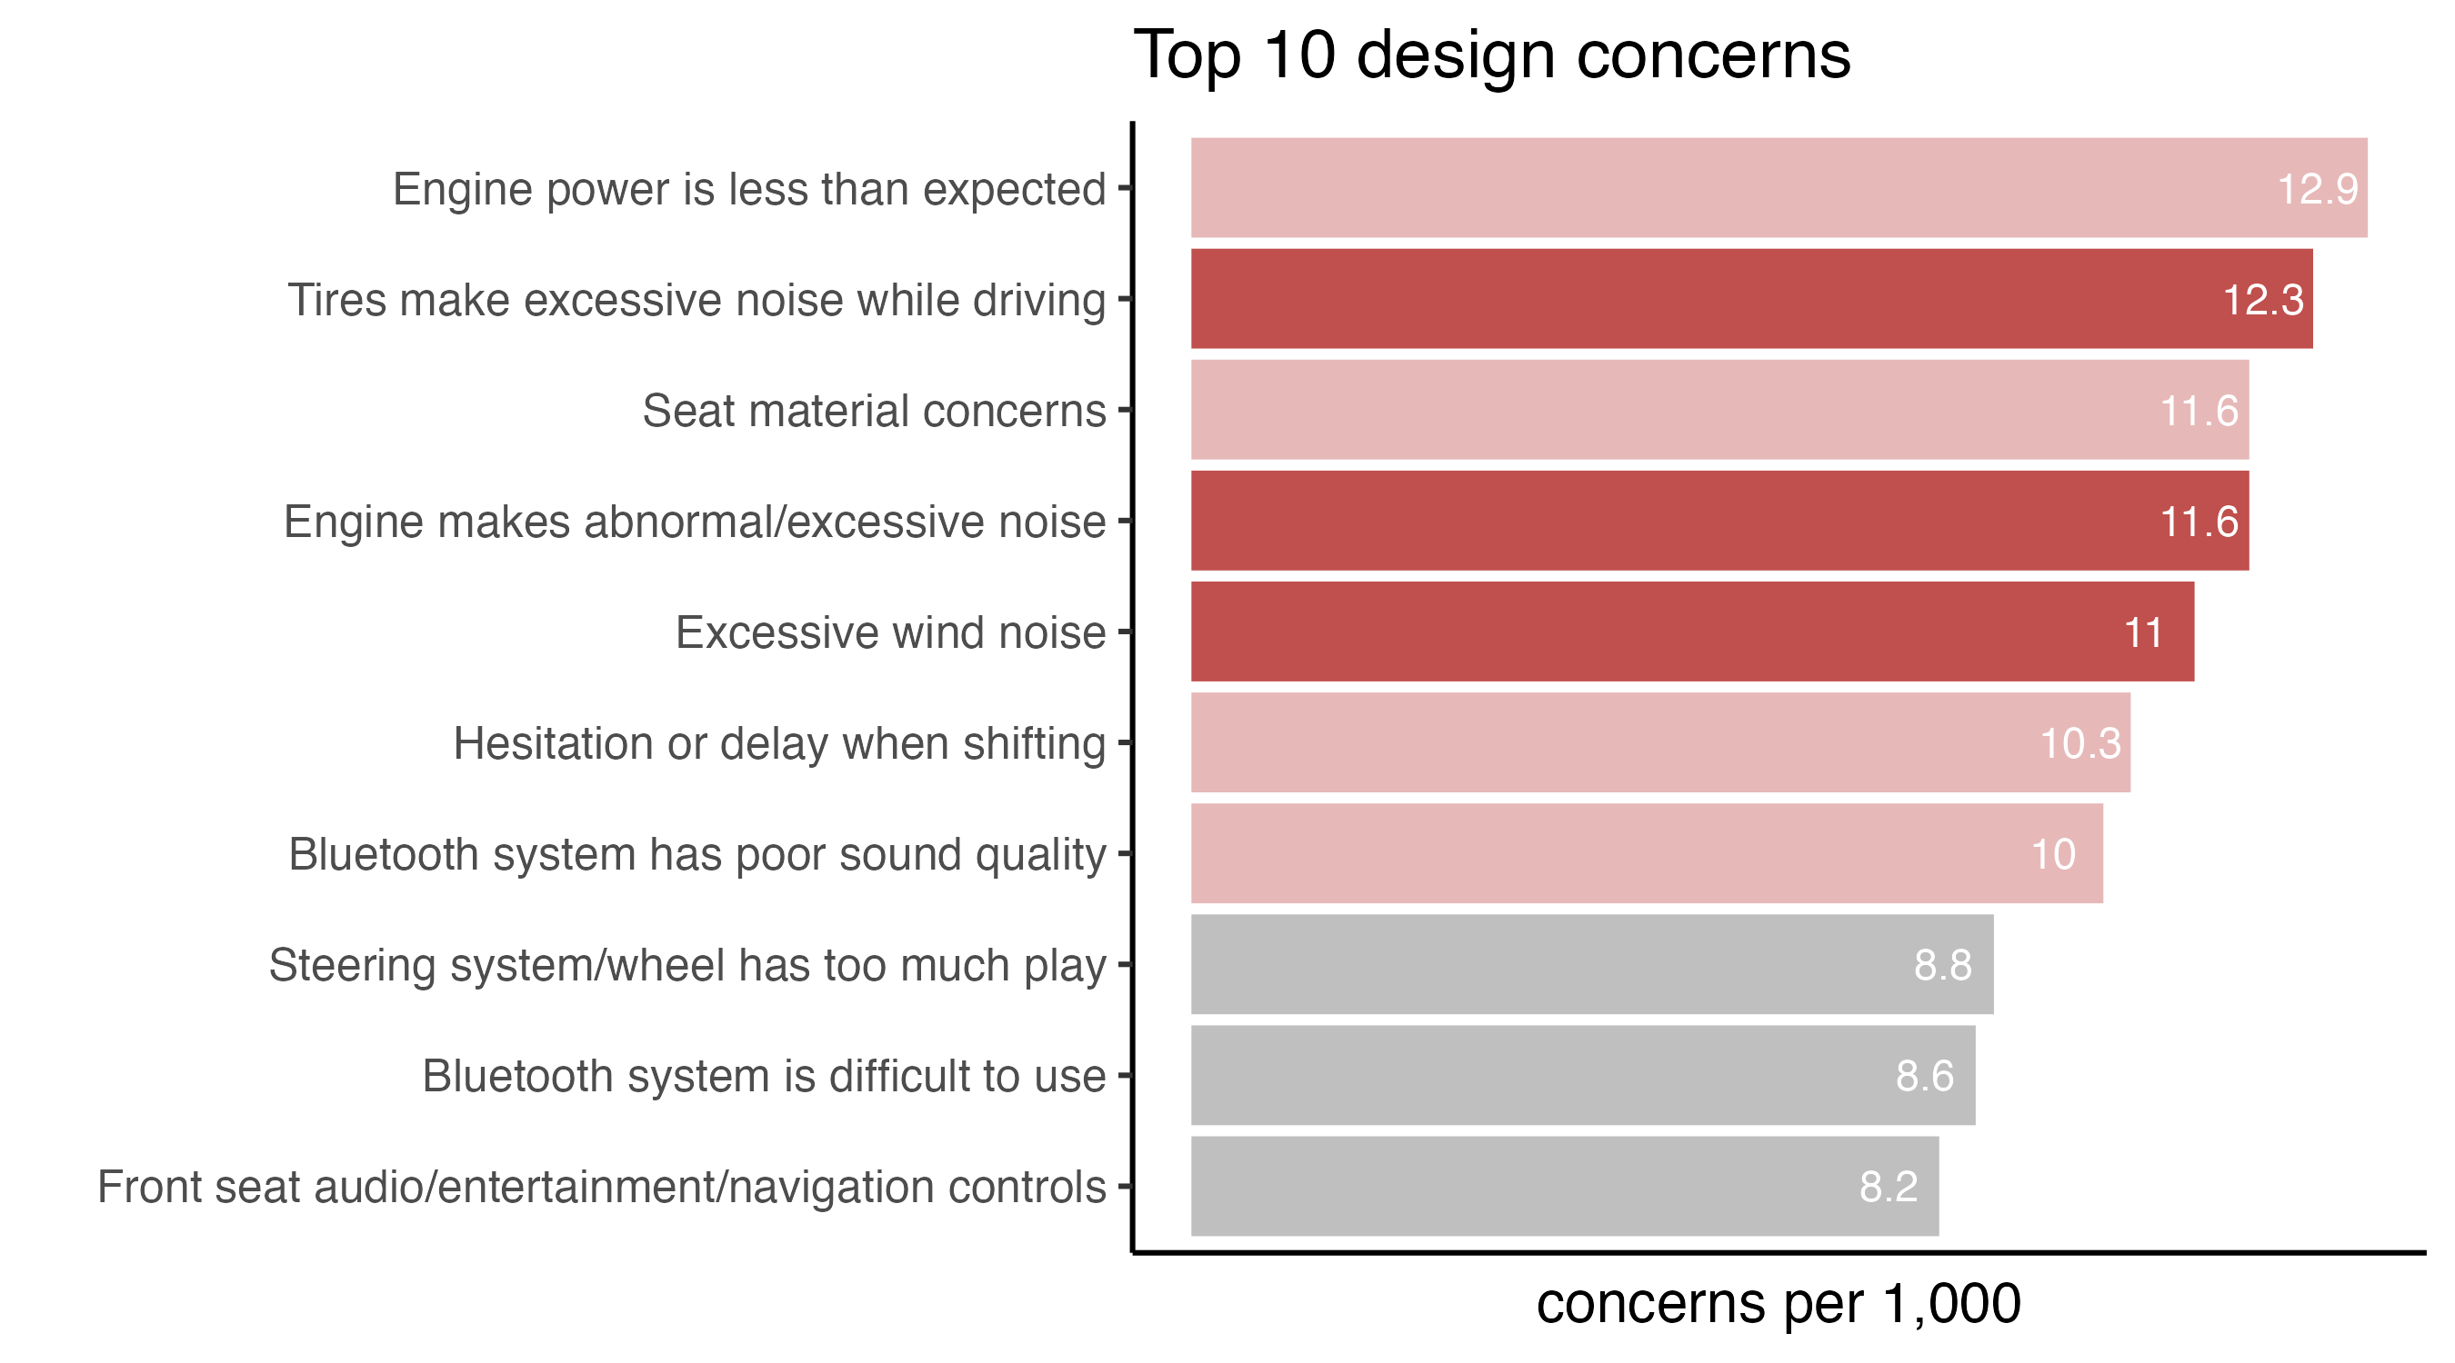
Additional preattentive attributes
Comments indicate that noisy tire issues are the most apparent in the rain.
Complaints about engine noise commonly cited after the car had not been driven for a while.
Excessive wind noise is noted primarily in freeway driving at high speeds.
Notes:
What have we done to the chart?
How does it enhance our understanding?
What benefit is there for repeating the same chart with different treatments?

Slide 12
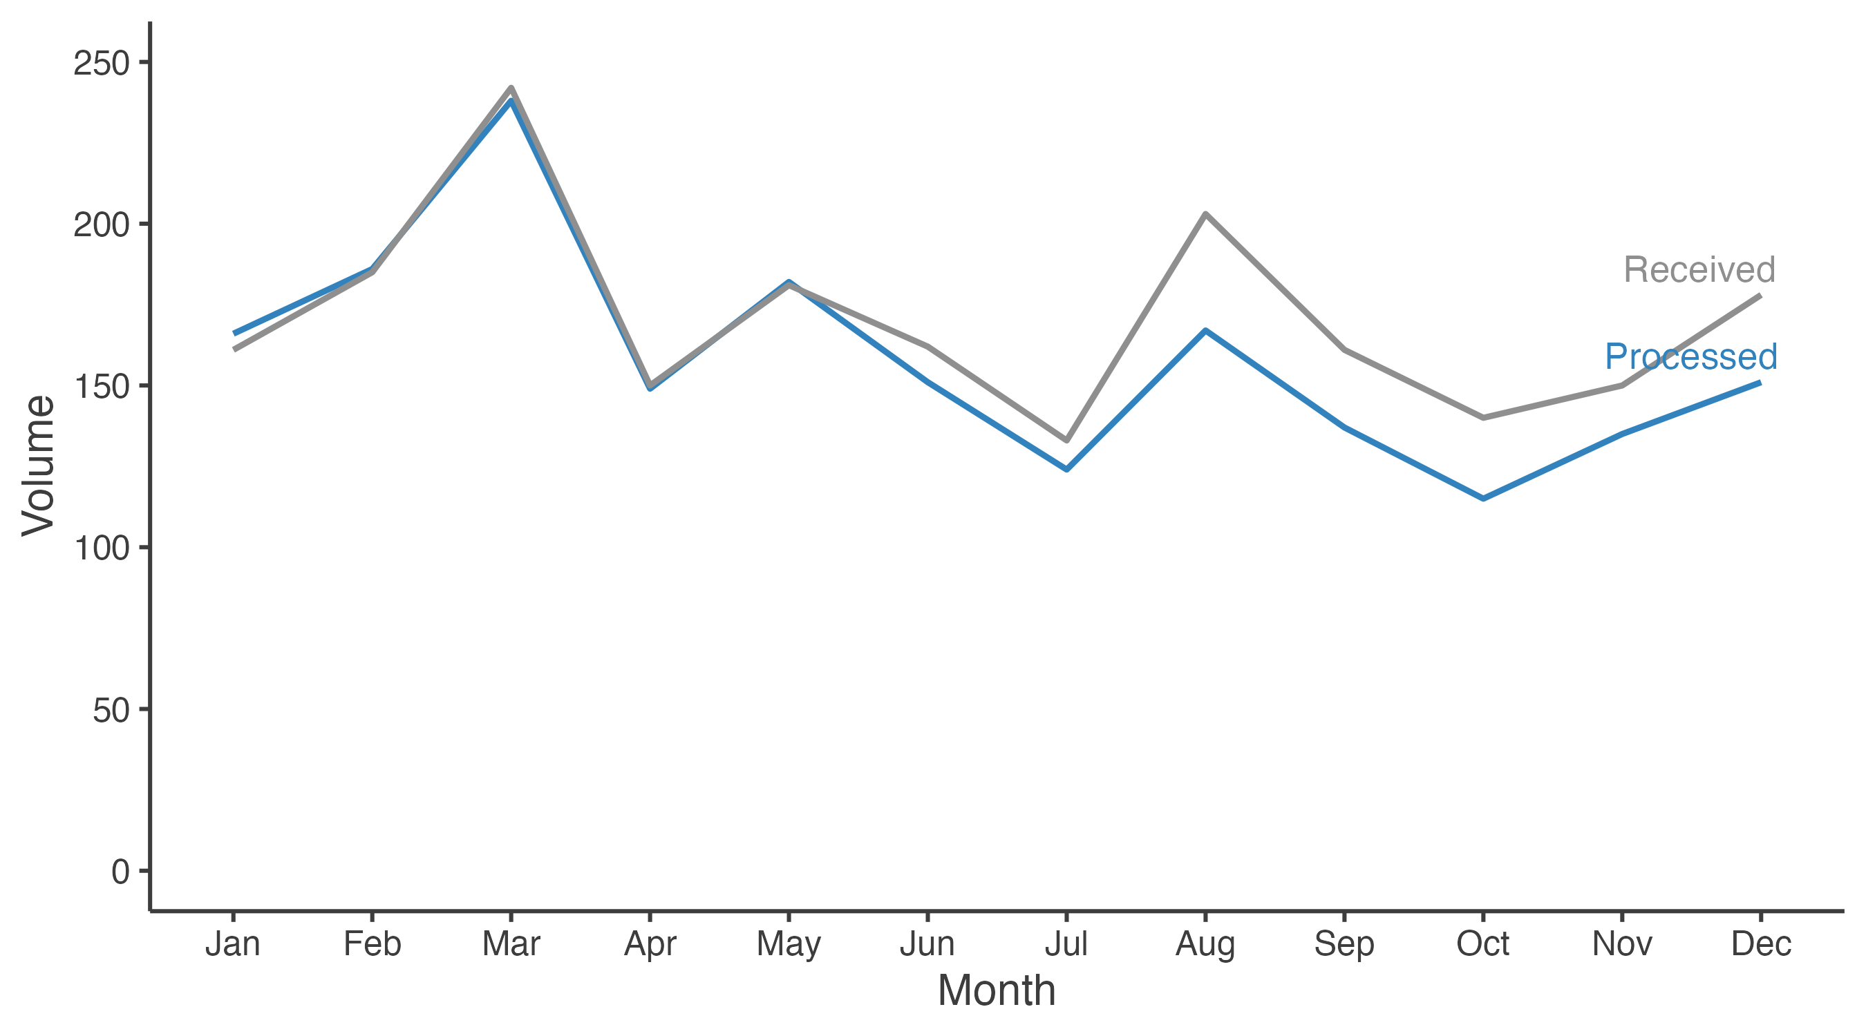
Using color to draw attention
Recall this graph from the text.
Used in the discussion of how to de-clutter.
Will use it to discuss using color to draw the audience’s attention.
Notes:
One strategy we can use is to de-emphasize everything using color.

Slide 13
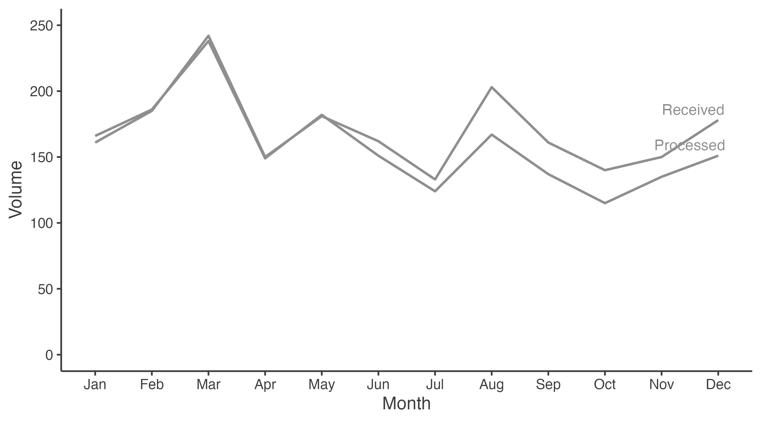
Default reading pattern
Notes:
Where does your eye go?
What does the author want you to understand from this chart?

Slide 14
Adding color
Notes:
Where does your eye go?
What does the author want you to understand from this chart?

Slide 15
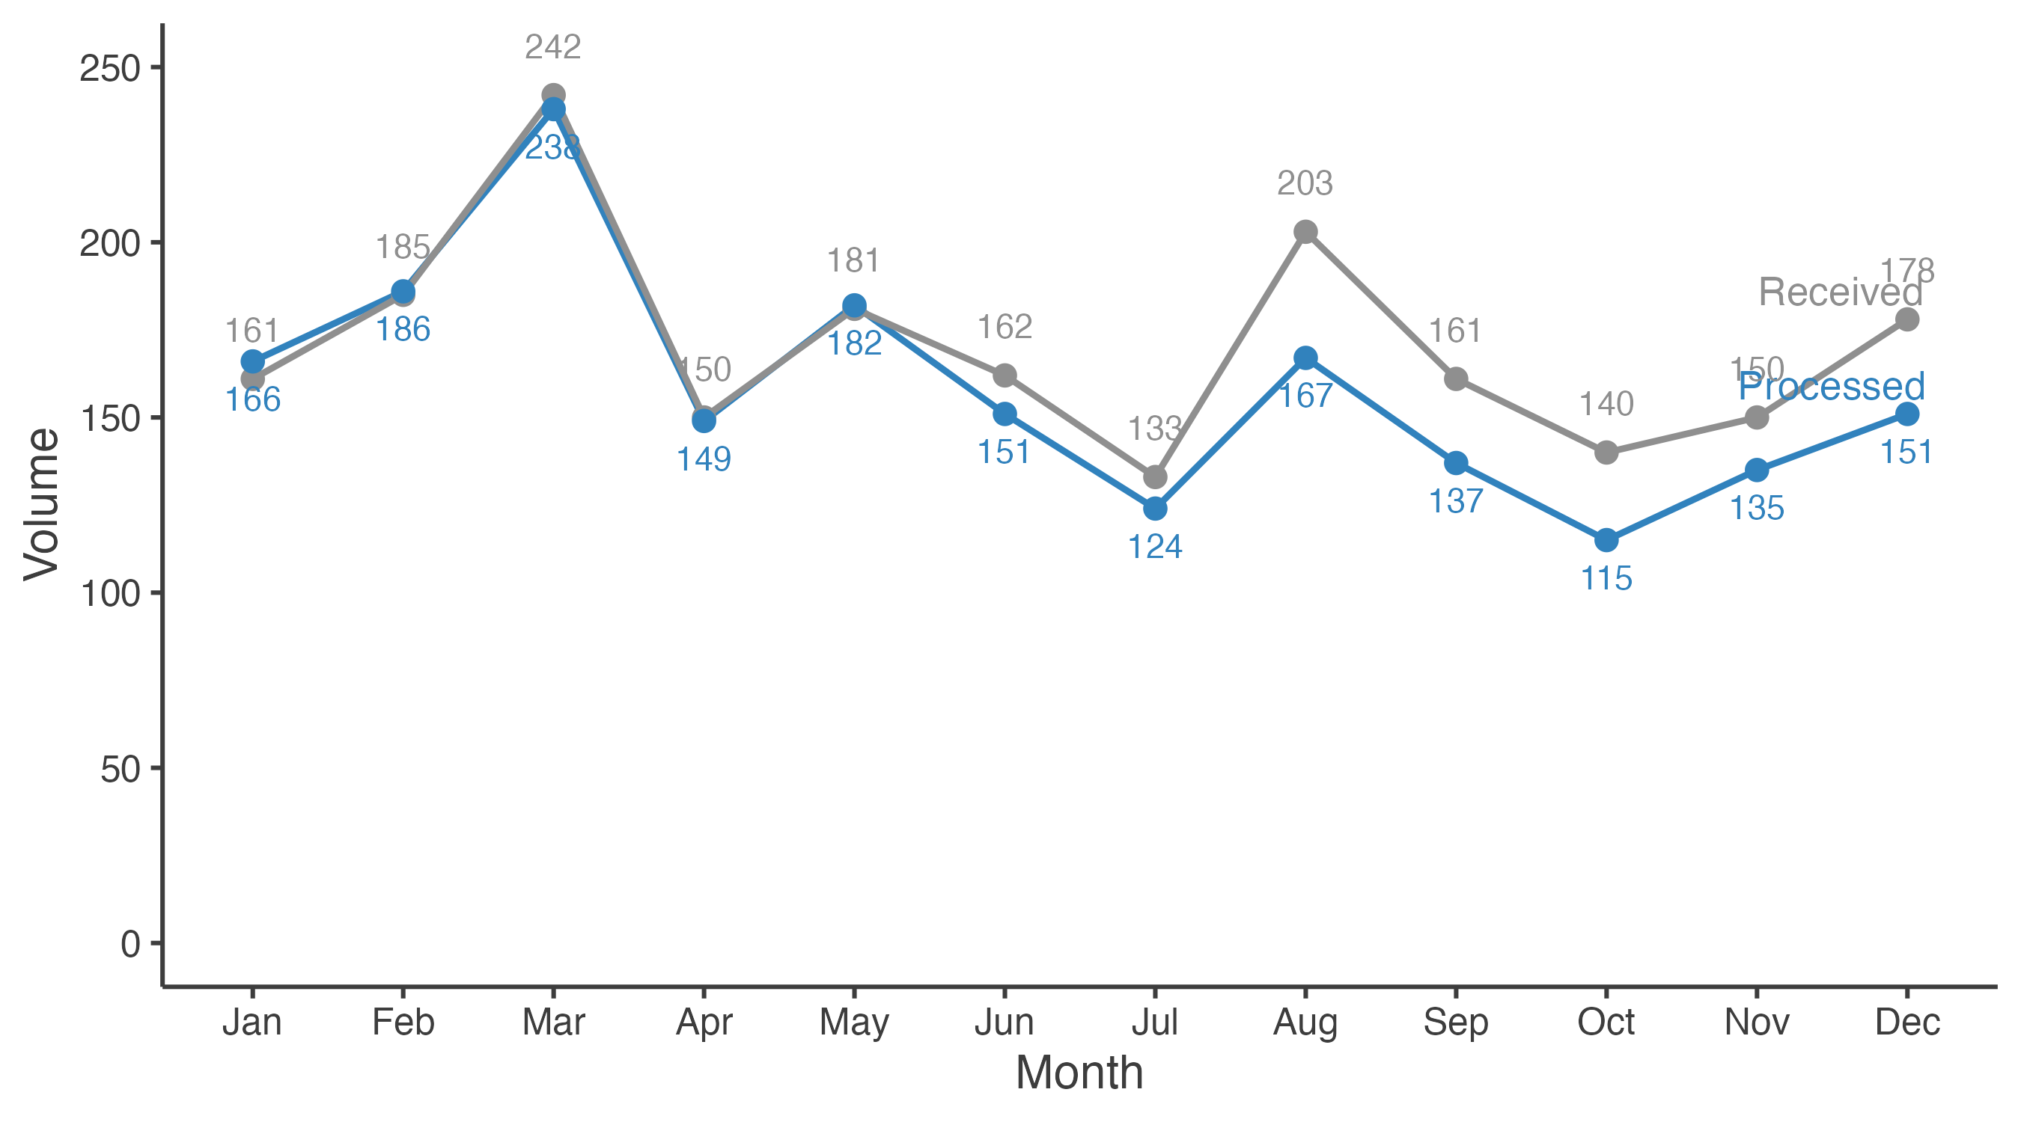
Added marks – labels
Notes:
Labels would be considered “added marks”
You can see here that adding labels for all points makes things more cluttered.
Especially note the placement of some of the labels.
This can be an issue in any tool and requires some tweaking to make sure labels end up in the right places.

Slide 16
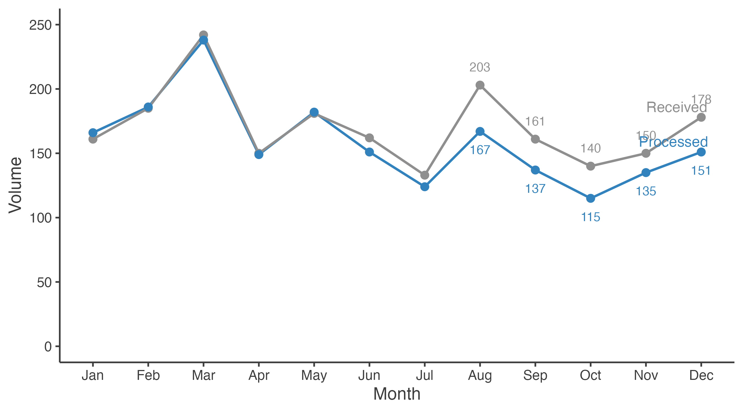
Added marks – partial labels
Notes:
Now we limit which points we label.
What happens to your attention now?
Still have overlap issues…

Slide 17

Strategic Preattentive Attributes

Slide 18
size
Relative size denotes relative importance
Make sure you use size intentionally, otherwise your audience will not focus where you want them to.
This is especially true when you have multiple visualizations displayed at once

Slide 19
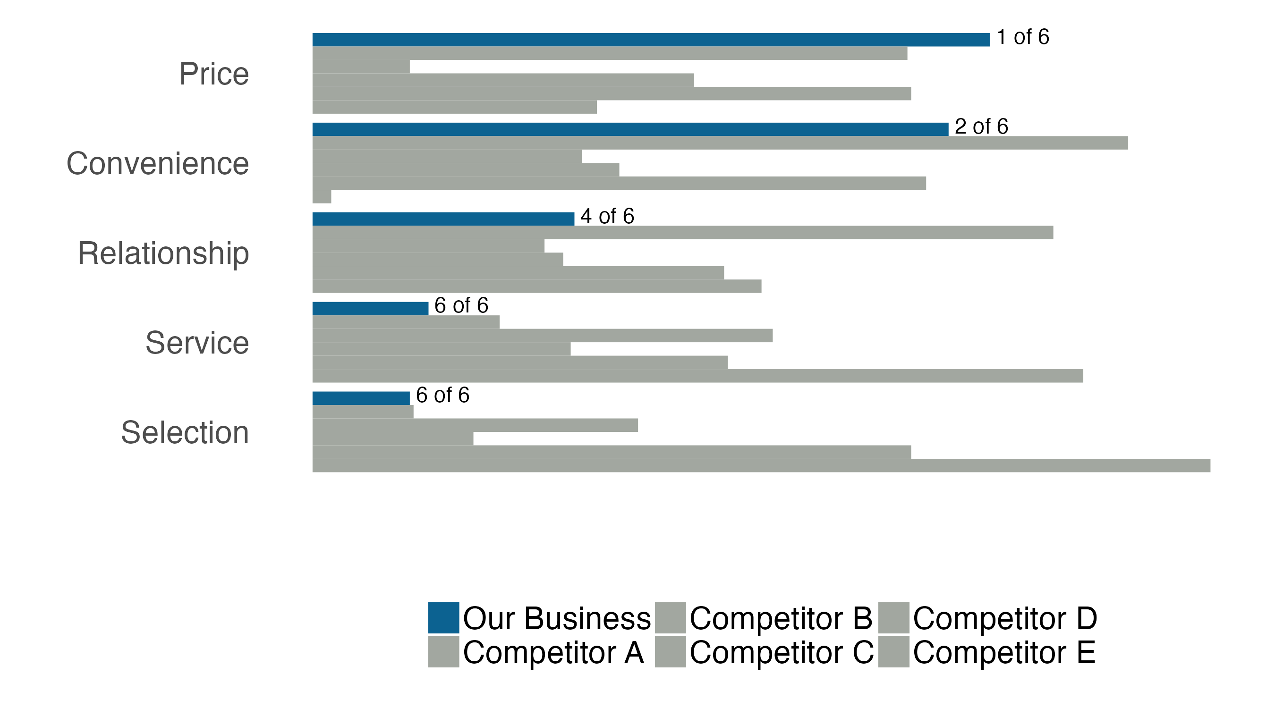
Which chart should you focus on?

Slide 20
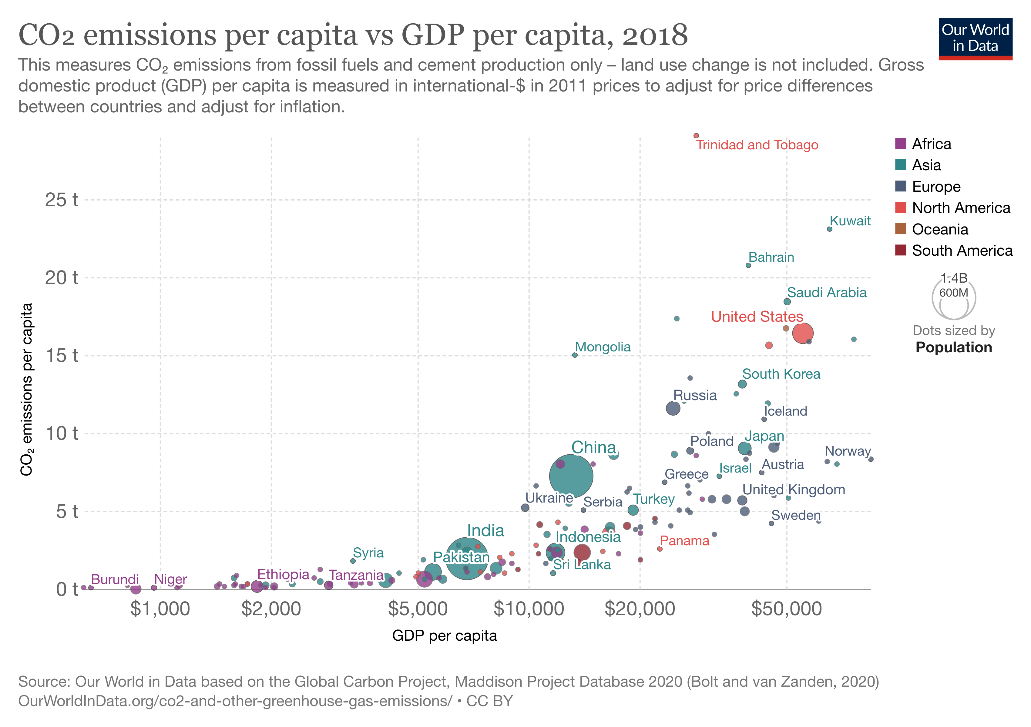
Size is why bubble charts work
Bubble charts take advantage of this preattentive attribute b/c it shows emphasis, and we naturally equate numeric meaning to size.

Slide 21
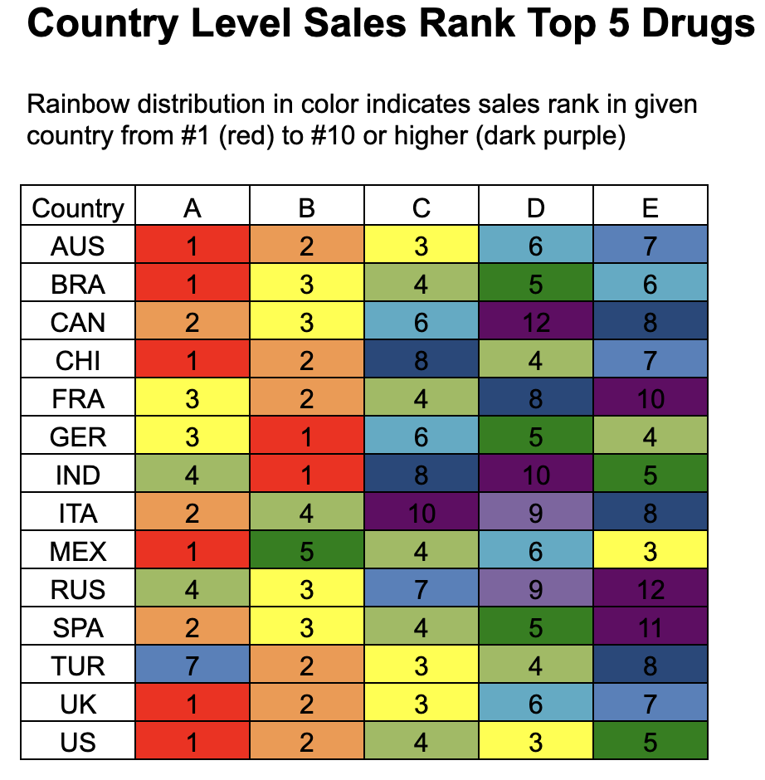
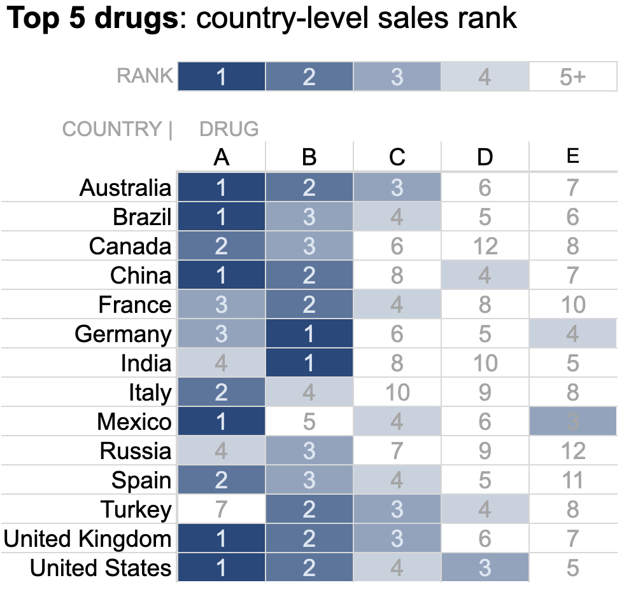
Use color sparingly
Too many colors
Distracting
Lose preattentive value
Sparing use of saturation (not hue/color)
Saturation is associated with a numerical value!
Eye is now drawn to darker colors

Slide 22
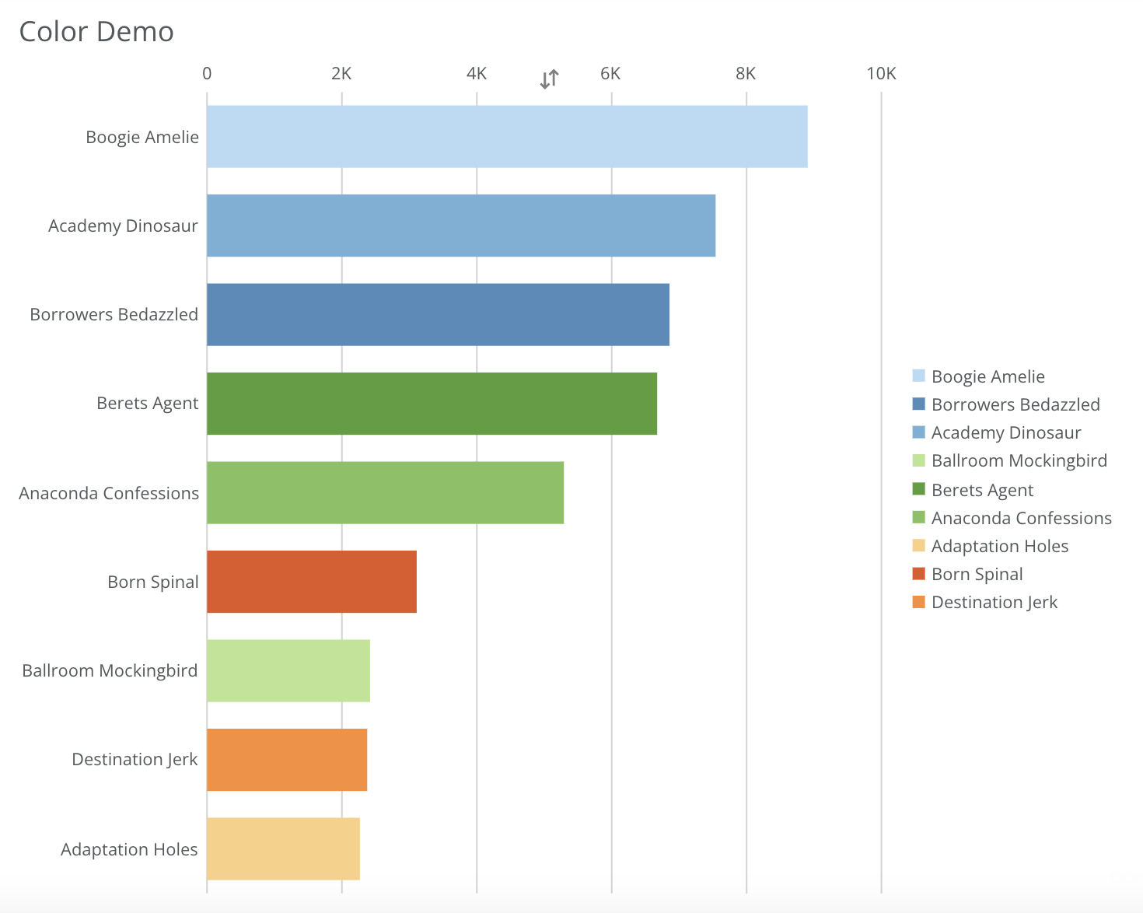
Use color intentionally
Why are the bars different colors?
What else do you notice?

Slide 23
other notes on color
Use color consistently
Should we change colors in our charts to keep things interesting?
Using color consistently means you train your audience to know what to expect. Colors should only change if meaning changes.
Design with colorblindness in mind
8% of men and 0.5% of women are colorblind
Avoid using shades of red and green together. If you need red/green, make sure there’s some other visual indication of difference.
Be thoughtful of tone
Color evokes emotion
Be thoughtful of how the results will be perceived. Softer tones could come across as too “nice”. Bolder tones more aggressive.
Brand colors
Do you use them?
In most circumstances, yes. But, brand colors may not have been chosen with data visualizations in mind. When brand colors can’t be used, use standard colors (black, grey) or pick a complementary color.

Slide 24
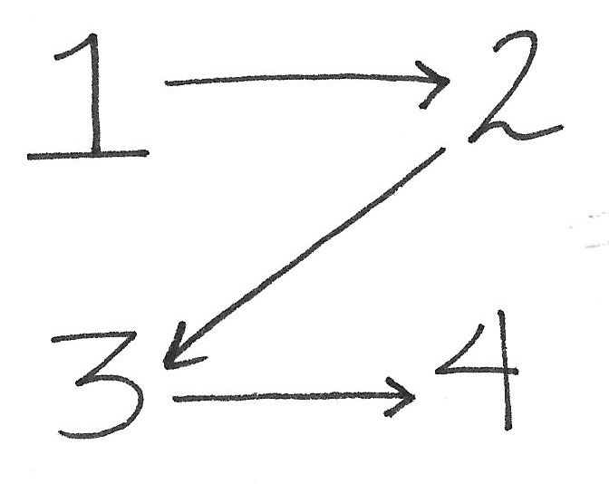
Page placement and visual cues
Without other visual cues, most members of you audience will read in a Z pattern (left to right, top to bottom).
Take advantage of this by placing things on the page in this order.
Don’t make your audience work too hard (they may not get your point).
On a related note, when possible, make sure your charts follow generally acceptable patterns (e.g. negative values on the left, positive on the right).

Slide 25

Using preattentive attributes
Guideline: use preattentive attributes sparingly; too many reduces focus for the audience
Process steps:
Start with everything “untreated”
“Treat” aspects of the data visualization one at a time with an effective preattentive attribute
(Stop before you add too many “treatments”)

